Slide 1
The impact of competition and consumer choice for law firms
Peter Scott
PETER SCOTT CONSULTING
www.peterscottconsult.co.uk

Slide 2
Some challenges now facing law firms
The economy
Client needs are changing
New well-resourced market competitors
Greater regulation and compliance
PI insurers’ attitudes
Technology
Globalisation
A fragmented profession
Greater need for resource
In the light of these challenges, law firms must become more competitive

Slide 3
All these challenges are risks for law firms
“It has got to make financial sense, but you have to see risk management as one of your strategic objectives. Business resilience is actually a competitive advantage”
Cedric Lenoire, head of FM Global’s risk consulting division – quoted in the Times 21 January 2013

Slide 4
There is an urgent need for law firms to change to meet these challenges
“There seems to be a disturbing strategy of hunkering
down, cutting some fat and hoping that business will
return to normal. That is not good. The terrain will look
very different when this is over. This is not a minor blip,
but a discontinuity”
Professor Richard Susskind – May 2009

Slide 5
The greatest danger?
- complacency!
“Our strategy is to keep a lid on
expenditure and weather the storm. We
cannot reinvent ourselves as something
we are not”
Managing Partner of a major London law firm – Autumn 2008

Slide 6
Manage change to become more competitive
“Competition is a process by which …
services that people are not prepared to
pay for
high cost methods of production and inefficient
organisations
are weeded out and
opportunity is given for new…services methods and organisations to be tried” *
This is the space ABSs and others are already filling
*Everyman’s Dictionary of Economics – A. Seldon and F. G. Pennance 1964

Slide 7
What do client’s want?
“They always try to sell to us on price – but what we really want is to have a good job done at a reasonable price”
Client feedback from a perception survey commissioned by
a law firm

Slide 8
The core issue to be competitive is to add value to clients
More than your rivals
In a way which is regarded as valuable by clients
Needs to be value clients care about
- clients’ perspective
- not yours

Slide 9
You will add value to clients and build your competitive advantage if…
You provide clients with what they want
At prices they perceive to be value for money; and
You do this better than your rivals

Slide 10
How will you position your firm, by adding value which your clients care about? (Brown and Faulkner 1994, Long Range Planning)
High
Low value added
High value added
Client
Perceived
Added
Value
Ave
X
Suicide Zone
Low
Low
Ave
High
Client Perceived Cost

Slide 11
Low Value – Added Services
Low value –added firms compete on processes and price – technology driven services with minimum professional input
Value enhanced by
- driving down cost
- facilitating implementation of
solutions
Invest in standardising processes

Slide 12
Issues in providing Low Value – Added Services
To hold position you must constantly squeeze out more value for same cost
Ensure financial strength to stay the course
Avoid creating the perception of reduced “quality”

Slide 13
High Value – Added Services
High value- added services – strategic impact on client – generally wisdom/experience driven
Identify and recognise needs of the decision maker
Understand client’s needs
Nurture wisdom/experience within the firm
Ensure added value is perceived as valuable

Slide 14
Moving to High Value Added Services
Focus on specific client types/work types
Seek market leadership in a few, cohesive segments
Understand how brand influences Client Perceived Added Value - brand is about differentiating yourself

Slide 15
What kind of law firm do we want to be? (Brown and Faulkner 1994, Long Range Planning)
High
Low value added
High value added
Client
Perceived
Added
Value
Ave
X
Suicide Zone
Low
Low
Ave
High
Client Perceived Cost

Slide 16
To meet these challenges -
A law firm will need to develop -
‘A realistic plan or course of action to gain competitive advantage;
Which has clear and achievable objectives; and
Uses available (but scarce) resources (existing or to be generated)

Slide 17
Strategy is about how to develop a realistic vision of the kind of law firm you want to be
Have you developed a vision for
your firm to build a law firm which
can begin to compete with larger,
more developed and better
resourced firms to gain
competitive advantage and
profitability?

Slide 18
Strategy is about forward planning
Focus on the BIG ISSUES
The kind of firm you want to be
Your clients
Your people
Resource

Slide 19
BIG ISSUES?
For example -
List [six] changes which would make the
greatest beneficial difference to your firm

Slide 20
When did you last do a SWOT analysis?
PETER SCOTT CONSULTING
Strengths?
Weaknesses?
Opportunities?
Threats?

Slide 21
Focus on the fundamentals of your business

Slide 22
Do you know what your clients will want from you in the future? Are your people able / willing to deliver what your clients will want?

Slide 23
You have developed a realistic strategic plan
You know what kind of firm you want to build, but …
Will you be able to achieve your objectives on your own?
Do you have the resources to do so?

Slide 24
The need for resource
Often a lack of
resource of expertise
(client perception surveys will show if this is the case)
financial resource
(inability to invest in your people and in the business)

Slide 25
Lack of expertise – in breadth and depth
Actual – to provide clients with the added value they require
Perceived – by clients when you are compared to competitors

Slide 26
Financial resource is needed to ….
provide for
quality leadership and management
infrastructure to underpin provision of high quality legal services:
- KM
- compliance and risk management
- HR (a people business!)
- Technology
- financial expertise
Build
market share and profile to attract and retain
- better quality people
- more profitable clients

Slide 27
Can consolidation in this fragmented and challenged legal profession help build competitive advantage?
NB – consolidation is not a panacea
often just a better platform on which to build a more
competitive law firm
not about size for the sake of size

Slide 28
Consolidate for the right reasons
PETER SCOTT CONSULTING
Consolidation is not a strategy – it is a means to an end – to gain competitive advantage
Consolidation can help build RESOURCE – to enable a firm to provide its clients
- with what they want
- at prices they consider value for money
- and do this better than rivals

Slide 29
The role of risk management in building a more competitive law firm
Operational
Reputational
People
Asset
Lack of knowledge
Regulatory
Financial
IT
Economic,
political,
fiscal
Competition
/business

Slide 30
Knowing your risks is key to avoiding them
Risk management
Knowledge management

Slide 31
Risks to be managed when building a competitive law firm
Ignoring client feedback
Ignoring your people
Failure to build financial resource
Failure to manage risks when undertaking consolidation

Slide 32
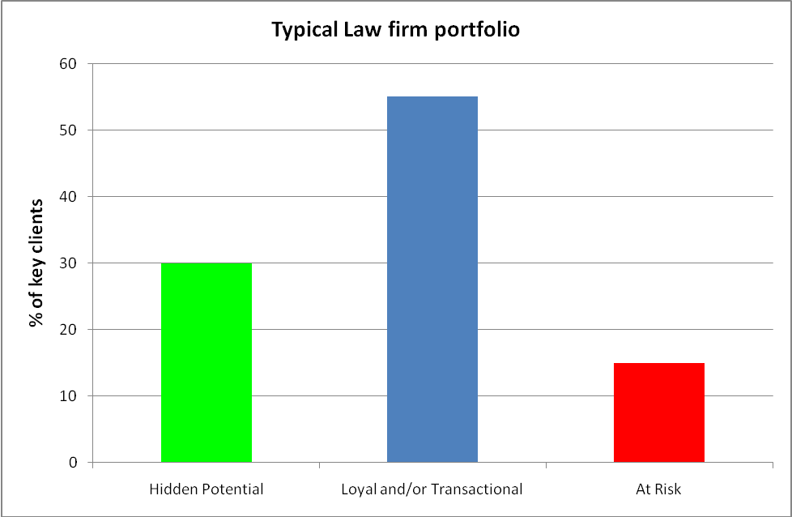
Ignoring client feedback

Slide 33
Ignoring client feedback
“For high value / high risk work I would use a big name firm – very unlikely to get bad advice”
“They are OK for most work but when it comes to something really important to us, we go [elsewhere]”
“If [named partner] is not there we go elsewhere because they lack depth of expertise.”
“They need to improve the quality of staff in the 2nd tier”.

Slide 34
Ignoring your people
For example, consider why partners leave law firms?
Reputation / profile of firm
Defined vision and strategy
Culture
Money
Career prospects
Quality of work / clients
Feeling valued / relative worth
Am I in the wrong firm?

Slide 35
Failure to build financial resource
Will result in an inability to -
Recruit and retain the best lawyers
Build the necessary infrastructure to underpin the provision of high quality legal services:
- management
- KM
- compliance and risk management
- HR (a people business!)
- Technology
- financial expertise (to ensure financial stability)

Slide 36
Failure to manage risks when growing by consolidation
Lack of market and sector knowledge
Lack of skills required to negotiate a merger / acquisition
Failing to carry out appropriate due diligence in relation to -
- financial position
- compliance with regulation
- claims record / PI experience
- people / reputational risks?
Lack of knowledge regarding how to implement a merger / acquisition

Slide 37
Why manage risk?
“The pursuit of excellence, with the aim of doing better for the clients” - the director of risk of a top 10 firm
If a firm is seen by its clients to be effectively managing the risks in its own business ‘in the pursuit of excellence, with the aim of doing better for clients’ then they are more likely to choose that firm to help them manage the risks in their businesses

Slide 38
Any questions?

